Slide 1
ENGINEERING ECONOMICS
Alban FERREOL
Julien LUBRANO
Dário TOMAZ

Slide 2
SUMMARY
Presentation of the game
Market analysis & Comparison
Starting capital, Incomes & Costs
Cash flows
Evolution & Expectations
Conclusion

Slide 3
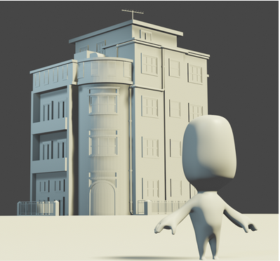

PRESENTATION OF THE GAME
2D “Point-and-click” adventure games
Puzzle and exploration
Strategy and deduction mechanics

Slide 4
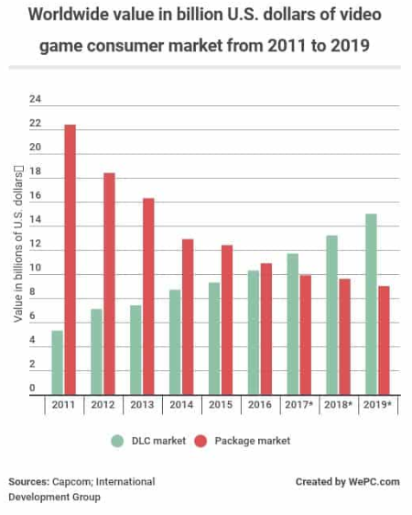
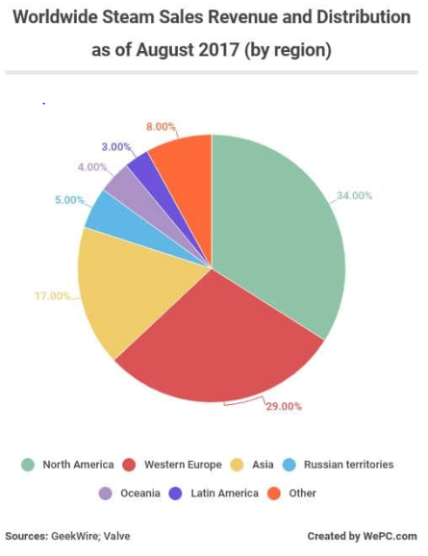
MARKET ANALYSIS
FIGURE 1
FIGURE 2

Slide 5
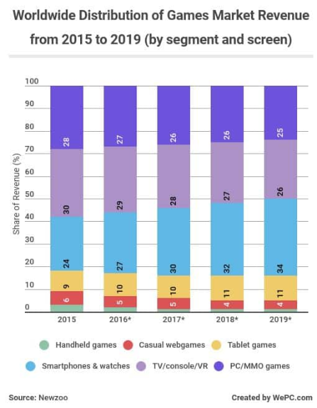
MARKET ANALYSIS
FIGURE 3

Slide 6


COMPARISON

Slide 7



STARTING CAPITAL
Contributed capital : 70k€
Loans : 40k€
Pre-orders

Slide 8
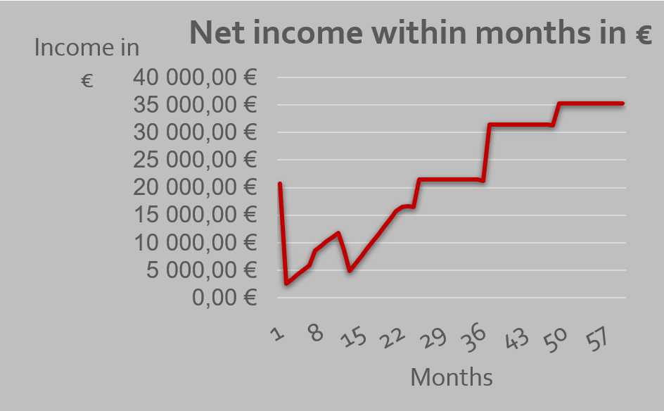




INCOMES
3 PC Products :
3 PC Products :
20€
10€
5€
GRAPH 1

Slide 9
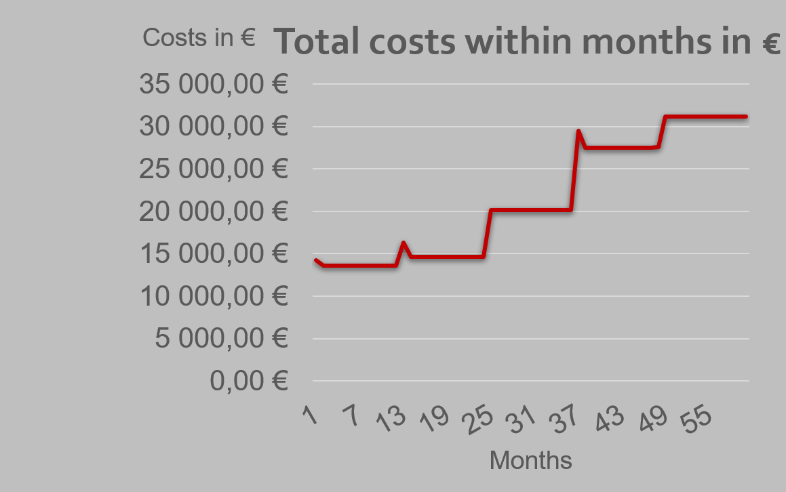
COSTS
Wages :
90k€ →165,6k€
Advertisement
Outsource : Design, sound, translation
Other : loans payback, investments….
GRAPH 2

Slide 10
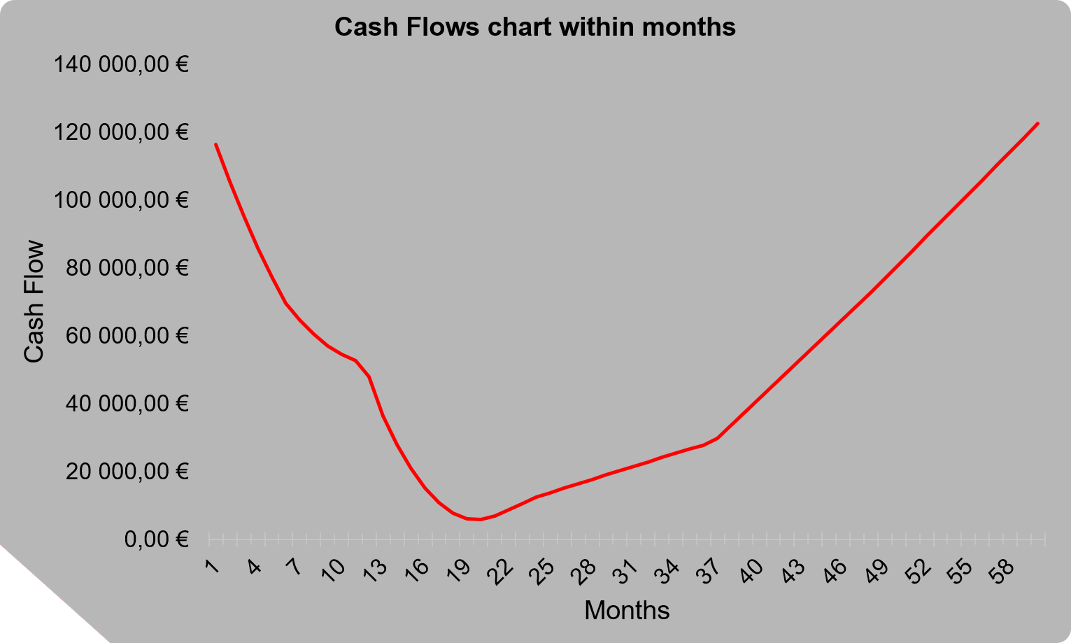
CASH FLOWS
GRAPH 3

Slide 11
EVOLUTION THROUGH THE 5 FIRST YEARS
Team
From 5 to 7 collaborators
Investments
Computers
Offices

Slide 12
AFTER THE 5 FIRST YEARS
2 Scenarios :
Develop a new game internally
Raise money to develop a bigger game

Slide 13
CONCLUSION
STRENGTHS :
Dedicated and committed team
Premium version available in pre-order
DLC : continuous revenue
Low fixed costs
OPPORTUNITIES :
Development for other platform
Improvement of game and levels
Development of other games (growth)
THREATS :
Steam dependency
Delay in game availability
WEAKNESSES :
Sales forecast error

Slide 14
REFERENCES
Figure 1 : Capcom international
Figure 2 : Geekwire
Figure 3 : Newzoo
Graph 1 : Excel + class
Graph 2 : Excel + class
Graph 3 : Excel + class

Slide 16
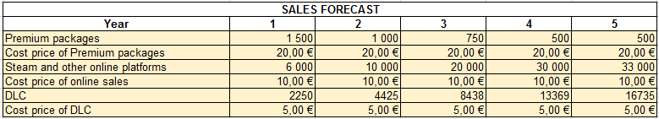
Table of sales forecast

Slide 17
Table of amortizations

Slide 18
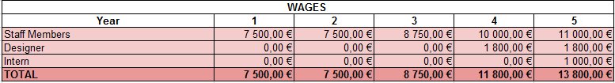
Payroll table per month

